Slide 1
Lightweight assistive technology: A wearable, optical-fiber gesture recognition system
Sanjay Seshan

Slide 2
Motivation

Slide 3
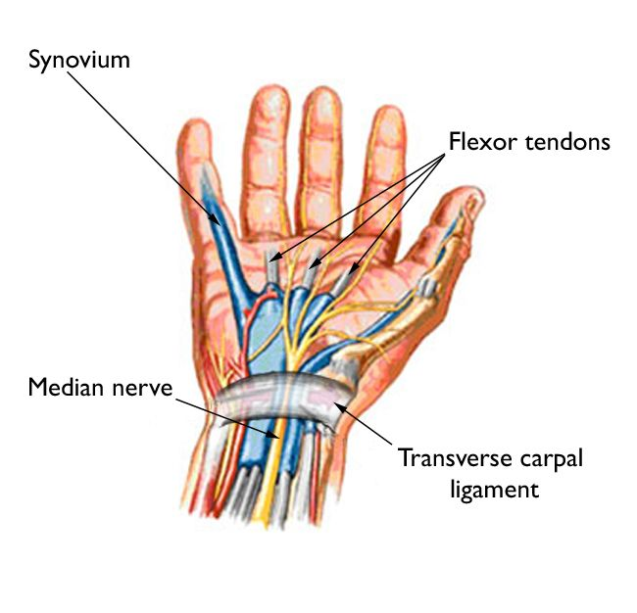
Basic idea
Transverse carpal ligament area
Deflection occurs when fingers [tendons] are moved
How to measure deflection?
Light

Slide 4
Basic setup for an optic fiber
LED
Fiber/light medium
Photoresistor/LDR
In order to detect the deflection using a LDR, a significant amount of light must be lost when the fiber is bent
Photoresistor/LDR
LED

Slide 5
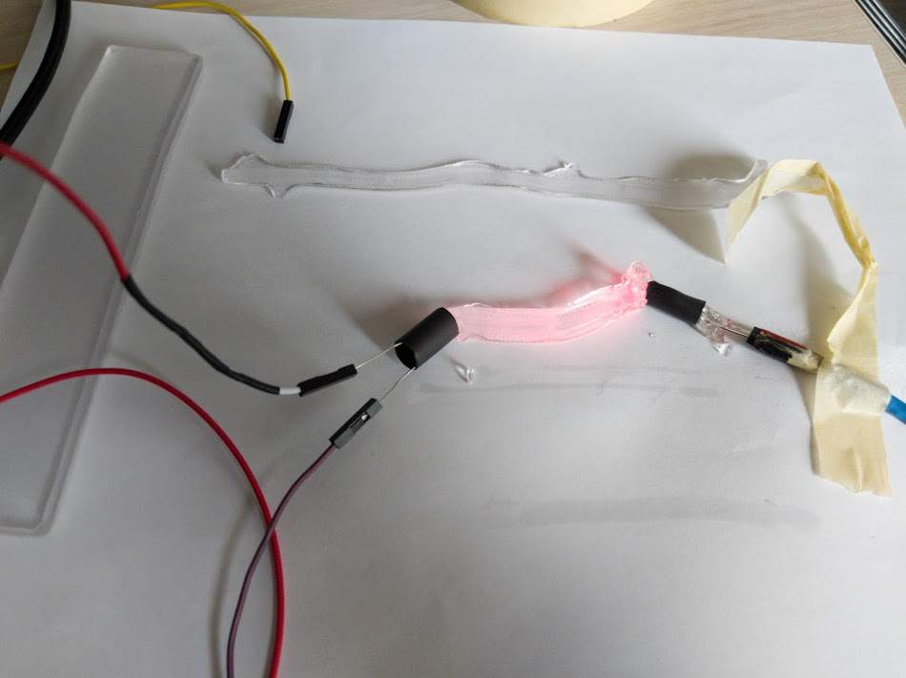
Materials/Mediums proposed
Standard optical fiber
Vytaflex – a semi-transparent urethane rubber
Ecoflex – an opaque silicone
Humimic gel – a transparent synthetic gelatin

Slide 6
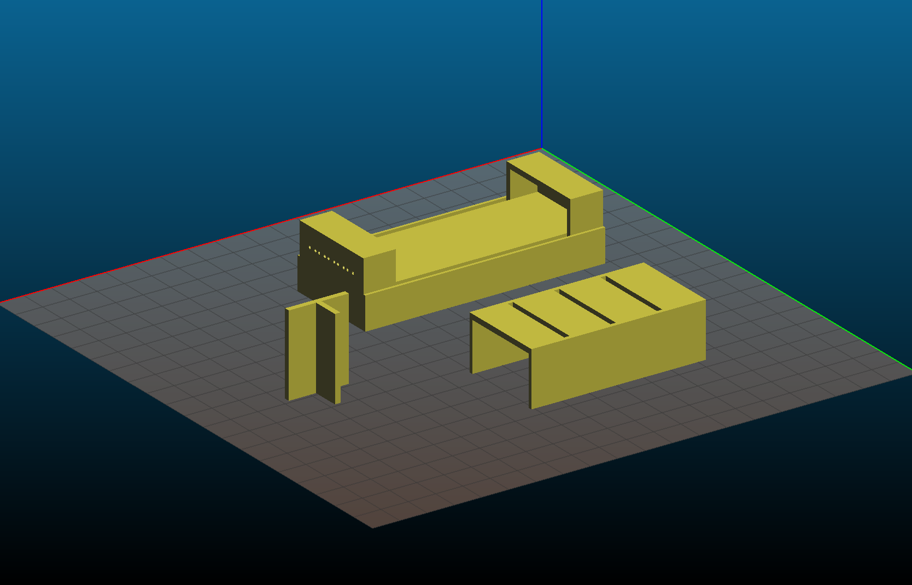
Testing process
Consistent 3d printed to isolate light
Holder for LED and LDR on each end
Plastic piece for consistent depression of medium

Slide 7
LED Color
Colour | Medium | Minimum Intensity | Maximum Intensity | delta Intensity | Notes
Large blue | Humimic #2 | 160 | 993 | 833
Large red | Humimic #2 | 183 | 1013 | 830
Large white | Humimic #2 | 205 | 1021 | 816
Small red | Humimic #2 | 180 | 977 | 797
Large red | Earth's atmosphere | 235 | 996 | 761 | Value seems to fall slowly
Large yellow | Humimic #2 | 210 | 971 | 761
Small green | Humimic #2 | 189 | 937 | 748
Large blue | Earth's atmosphere | 228 | 957 | 729
Large green | Humimic #2 | 185 | 850 | 665 | Value seems to fall rapidly
Small red | Earth's atmosphere | 245 | 864 | 619 | Value seems to fall slowly
Small green | Earth's atmosphere | 253 | 775 | 522
Large green | Earth's atmosphere | 240 | 720 | 480 | Value seems to fall rapidly
The optimal wavelength of the LDR must be determined
This does not depend on the material used
Humimic was used as a constant baseline
A 3d printed cast was used to eliminate external light
A constant depression was used to determine minimum intensity

Slide 8
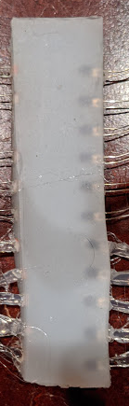
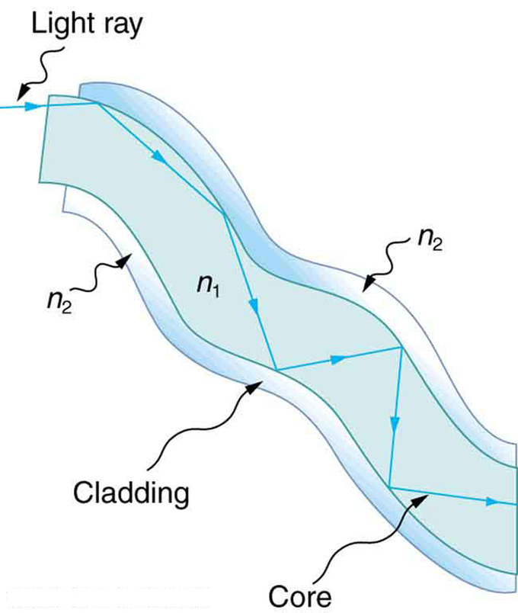
Problems with each material
Optic fibers were too perfect and there was no light deflection, even when bent over 90 degrees.
The internal reflection is too high
A non-ideal optical fiber is needed so that light is lost when bent
Ecoflex was too opaque and did not permit any light from the LED to pass
Humimic was too soft and melted/tore due to the body heat.
Humimic melts at about 50 degrees; body heat is about 40

Slide 9
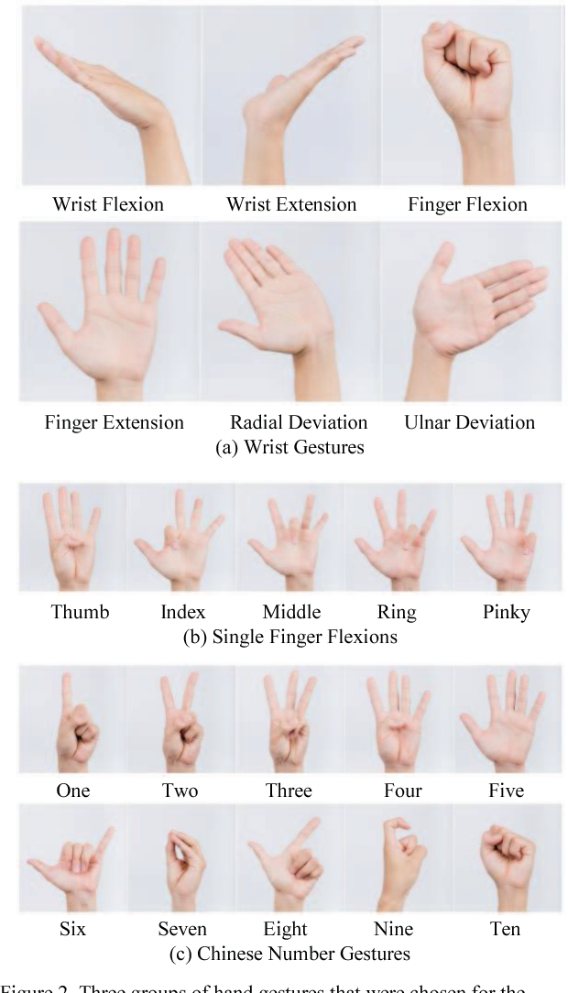
Gestures tested
Finger Extension [Extend]
Finger Flexion [Fist]
One
Two

Slide 10
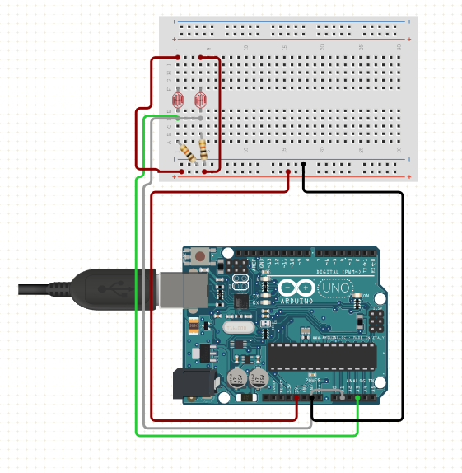
Collecting data
1 Arduino Uno
5 LDRs and 5 10k Ohm resistors
LED circuit:
9V battery, 5V regulator, 2 XXX resistors, 5 LEDs

Slide 11
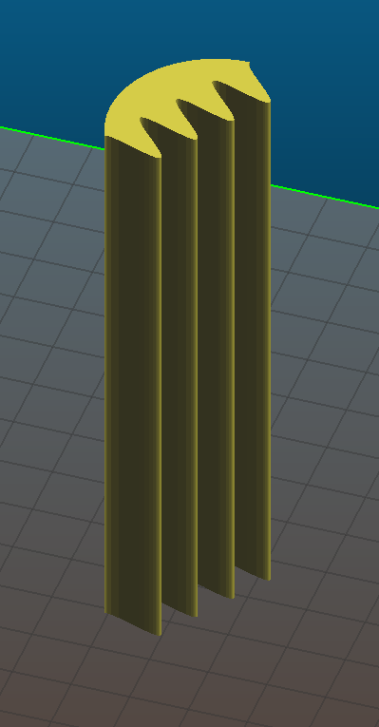
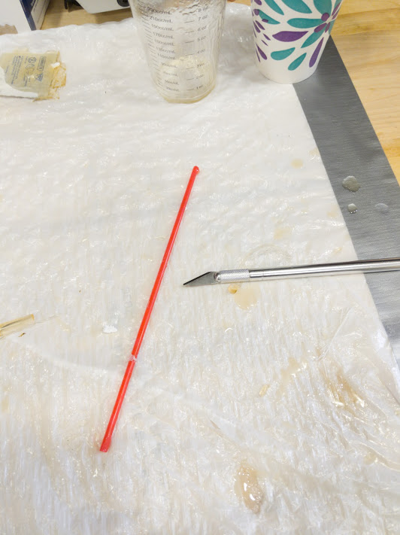
Different shapes tested
Tube
Shrink tube: 20mm, 5mm, 4mm
3d print: 2mm, 4mm, 5mm
Straws: 3mm, 5mm
Sinusoidal → manufactured by first casting a mold using Vytaflex (Silicone)
Rectangular
Minimize the diameter to keep multiple strands for higher resolution
Sinusoidal and Rectangular molds required sensors to be embedded = fragility
Shrink tube and 3d printed molds caused capillary action (the material stuck to the sides)
Straws proved to be the best mold – 3mm proved to be best for LED shape and resolution

Slide 12
Sample data: one

Slide 13

Cleaning up data
Use moving averages
$A_{n}=α∗x_{n}+\left(1−α\right)∗A_{n−1}$
3 are used to find the maximum, minimum, and transition period
This is used to label the data

Slide 14
Labelling the data
Compare individual moving averages to original
Time of determined maximum
Time of determined transition
Time of determined minimum

Slide 16
